Slide 1
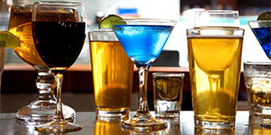
RACP Alcohol Policy
Inner Workings of a
Working Group
Paul Haber and
Steven Skov

Slide 2
Alcohol is a complex issue
RACP Congress 2014
Important benefits
Major Health and Social harms
A lifestyle, a risk factor, a disorder

Slide 3
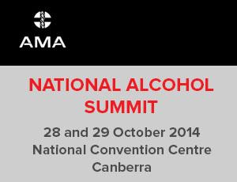
We cannot escape controversy
RACP Alcohol Policy 2014
What is popular is ineffective and what is effective is unpopular

Slide 4
How can we prevent the harms related to alcohol…
…Without changing anything???

Slide 5
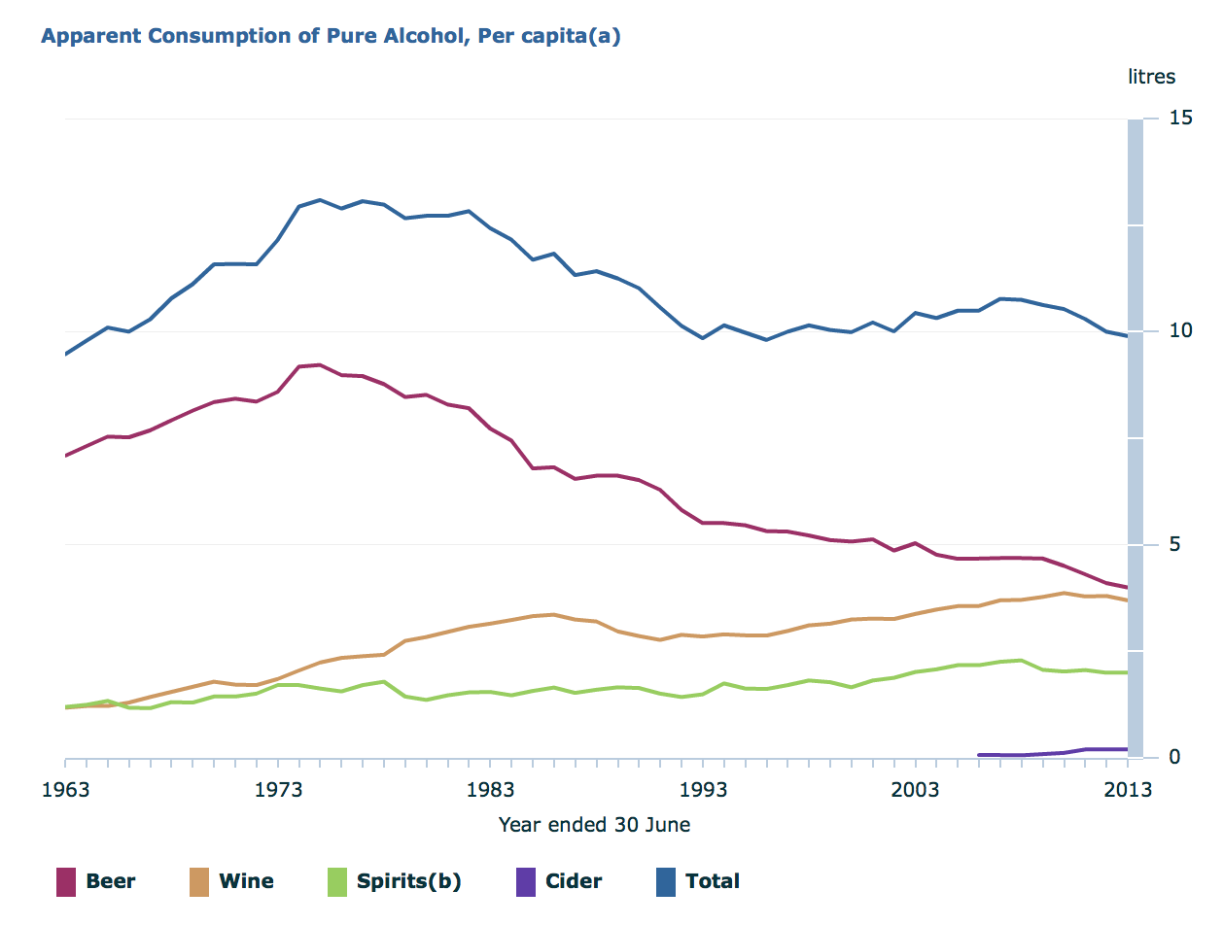
Apparent Consumption of Alcohol in Australia
ABS based on alcohol sales, 2014 report

Slide 6
First edition (2005) “Using evidence for better outcomes”
AMA Summit 2014
New evidence
New perspectives
New issues:
alcopops?
floor price?
drinking age?

Slide 7
Issues to consider
RACP Alcohol Policy 2014
New evidence
Health benefits
Pricing/taxation
Fetal alcohol exposure (FASD)
Alcohol & violence
Alcohol use disorders and access to treatment
New issues
Minimum legal drinking age
Passive drinking (harm to others)
Harms to young people and family

Slide 8
How can total consumption be reduced?
Strategies discussed at this meeting are endorsed by RACP Policy
“Price and availability”
Demand
Culture: advertising & promotion
Target 30% reduction (ANHPA)

Slide 9
Raising the minimum legal age for drinking Political suicide?
RACP Alcohol Policy
“From 2004 to 2010 the percentage supporting this policy increased from 40.7 per cent to 50.2 per cent”
John Toumbourou
Intermediate measures to increase the age for some types of access to alcohol, should be considered in the meantime.
Seven other countries?
http://www.deakin.edu.au/news/2014/120514increasinglegaldrinkingage.php

Slide 10
Alcohol pricing $9B raised in tax; $15B burden of disease
RACP Alcohol policy 2014
Volumetric tax
Floor price
Differentiate product risk:
Eg Light beer
Eg Alcopop
Hypothecation
Keep revenue for treatment

Slide 11
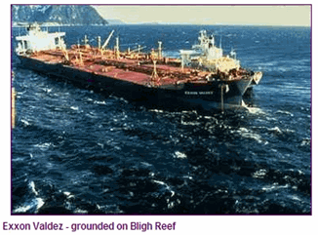
Passive drinking
Almost half the harms of drinking are borne by non- drinkers (eg MVA, assaults) (Nutt, Lancet 2010)
Australian burden estimated at $20B (FARE 2010)
Increase measures to protect non-drinkers
Enforce abstinence in safety sensitive settings
Identification: screening & intervention (e.g. DV)
Other?
*Exxon Valdez RCA revealed multiple issues http://www.valdezrca.com

Slide 12
Alcohol-related Mortality
Males | % | Females | %
Alc Cirrhosis | 25 | Alc Cirrhosis | 22
MVA | 12 | Haem. CVA | 9
Suicide | 7 | Breast Ca | 7
Haem. CVA | 6 | CRC | 7
CRC | 6 | MVA | 5
Pascal et al, National Alcohol Indicators, NDRI Bulletin No. 12, 2009

Slide 13
Increasing proportion of Australian hospital separations for liver disease are alcohol-related
All causes
43%
28%
Alcohol
Aust Inst Health Welfare (on-line data cube accessed Aug 2013)
‘Unspecified liver disease’ left un allocated (underestimates role of alcohol)

Slide 14
Alcohol Disorders in Australia
National survey of mental health and well-being
Overall,
4% Alcohol Dependence
750,000 people
Teesson et al, 2000 ANZJP

Slide 15
Hospital Seps 2012-2013
 | Same-day | Overnight | Total
Alcohol | 29105 | 34206 | 63311
All other drugs combined | 16834 | 33491 | 50325
Aust Nat Min Dataset report 2014 (AIHW)

Slide 16
Alcohol dominant main drug

Slide 17
Risk factors for alcohol use disorders
These indicate that drinking problems are not just a “moral weakness”
Genetic
Polygenic, eg DA receptor subtypes
4x risk of dependence if dependent father, even if reared apart
Males > females
Environmental/social
Availability, occupation, peer/family behaviour
Psychological trauma (eg childhood abuse), unemployment
Psychiatric illness

Slide 18
Role of stigma Patients, community, clinicians
One of the most highly stigmatised disorders
‘self-induced’… ‘moral weakness’
Reluctant to acknowledge disorder
Treatment delay average 20yrs after onset
Reluctance to provide treatment by some
Reluctance to diagnose or code diagnosis
Treatment retention poor (average <1/12)

Slide 19
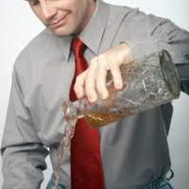
Alcohol use disorders
Treatment
Despite evidence treatment is effective
Serious shortage of treatment services:
Limited access by region and demographic
Evidence based treatments poorly utilised (Guidelines of 2009)
For example 0.5-1% are on pharmacotherapy
Limited support for research

Slide 20
Role of Specialists in “Addiction Medicine”
Policy
Advocacy
Clinical
Ambulatory Care
Hospital care
Consultation-liaison
Assessment/Report impairment for 3rd party
Teaching & Research

Slide 21
Challenges in Addiction Med
Highly stigmatised field
Difficult to attract resources
Less well remunerated than other branches of medicine*
Ageing workforce (mean age 58)
Falling numbers despite growing role
Opportunities?
Dual training, great need, interesting career

