Slide 1
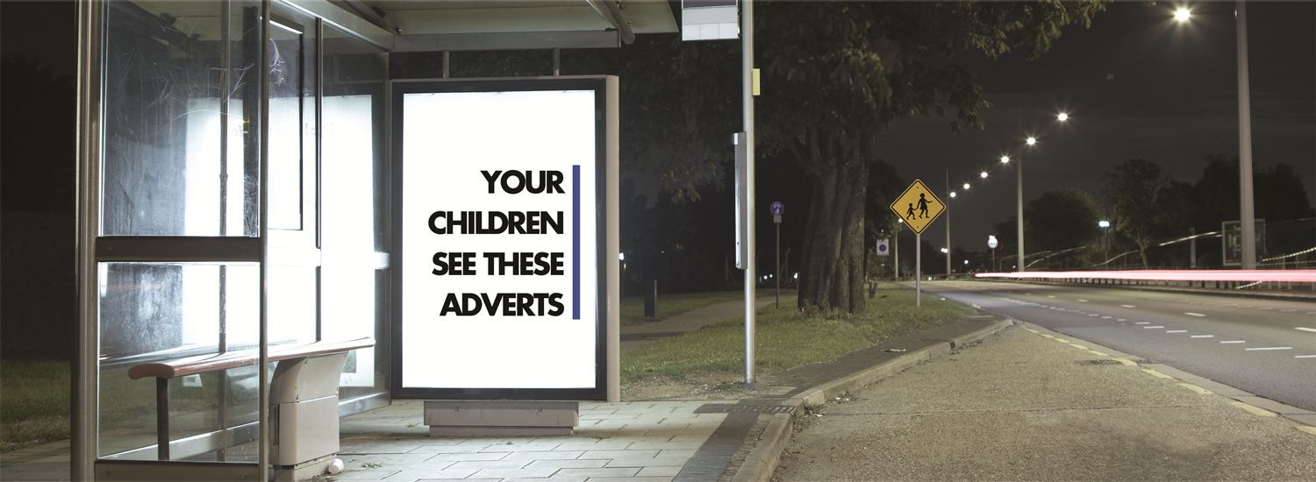
Deficiencies of alcohol advertising self-regulation and a new approach
Professor Mike Daube
McCusker Centre for Action on Alcohol and Youth
Acknowledgements – Hannah Pierce, Danica Keric, Julia Stafford

Slide 2

Top ten beer companies produce two-thirds of the worlds beer
Top ten spirits companies produce nearly half of the world’s spirits
10 wealthiest alcohol companies
  Total net revenue/turnover in 2010 of $159 billion
  Operating profits of $33 billion
If these companies were a country, they would rank 58th among the world’s 190-odd countries.

Slide 3
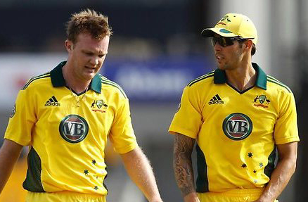
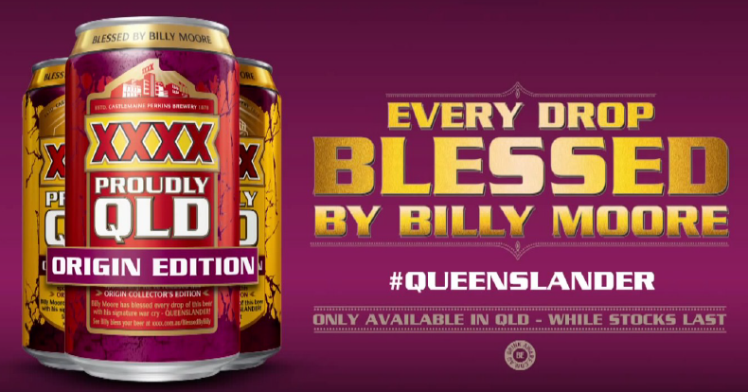
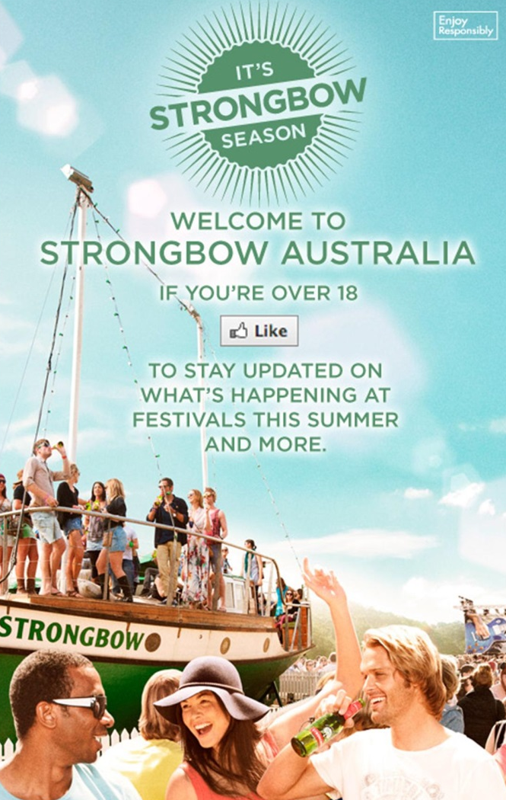
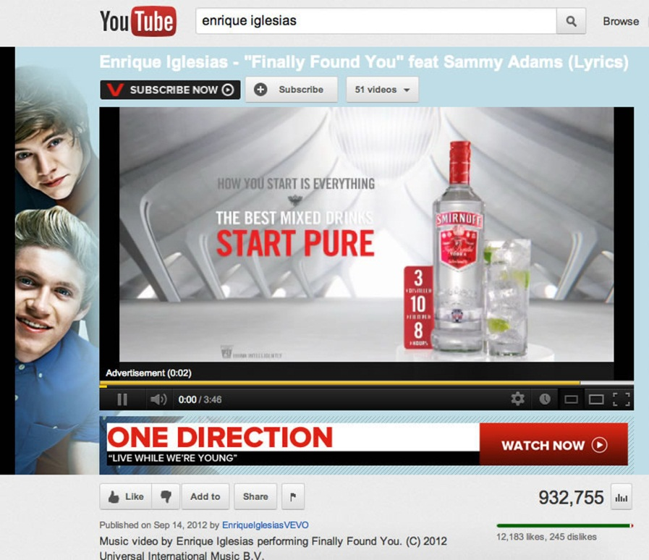
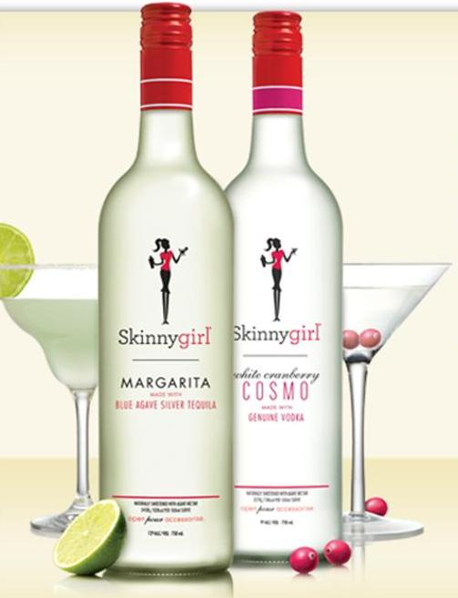

Slide 4
Impact of alcohol advertising on young people
Young people are routinely exposed to messages endorsing the use of alcohol products.
Exposure to alcohol promotion contributes to young people’s attitudes to drinking, drinking initiation and drinking at harmful levels.
Alcohol advertising contributes to the normalisation of alcohol.

Slide 5
“We don’t fundamentally believe that through our advertising encourages excessive consumption of alcohol.”
Jeremy Griffith, CUB, Corporate Relations Director
4 July 2012 (Triple J Hack)

Slide 6
“They’ll Drink Bucket Loads of the Stuff”
An Analysis of Internal Alcohol Industry Advertising Documents for the House of Commons Health Select Committee, 2009

Slide 7
"We understand beer has been declining for a couple of years now, as is alcohol with its per capita consumption. I think the first thing is we need to find ways to work harder to make people drink more and drink at higher value...”
Peter Filipovic, CUB, Sales Director
The Shout, September 2012

Slide 8
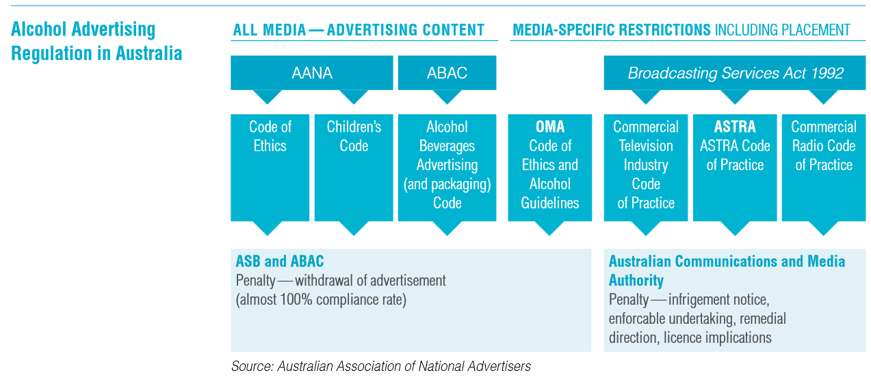
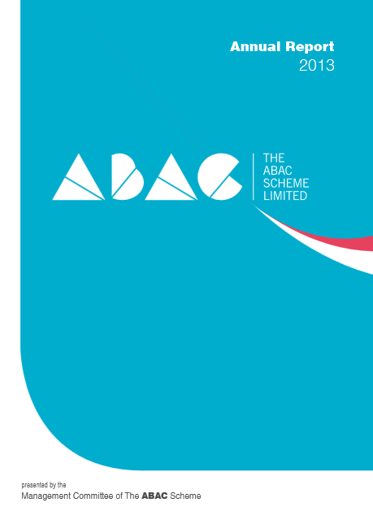
The ABAC Scheme Annual Report 2013, p3.

Slide 9
“If there is one weakness of the ABAC scheme, it is that by necessity it is a complex system and hence not at all easy to understand at first glance. This complexity is unavoidable because what it is regulating is complex.”
Gordon Broderick, Executive Director, DSICA (and ABAC Chair 2011)
National Liquor News, April 2012

Slide 10
“… the ABAC Scheme as currently operating is very effectively regulating alcohol advertising… We do not believe that the evidence-base is robust or strong that alcohol advertising influences overall alcohol consumption, underage consumption or age of alcohol initiation.”
Distilled Spirits Council of Australia, 2013
”Like other forms of promotion, there is no firm evidence that suggests a ban on sports sponsorship would lead to a reduction in alcohol misuse or underage consumption.”
Brewers Association of Australia and New Zealand, 2013

Slide 11
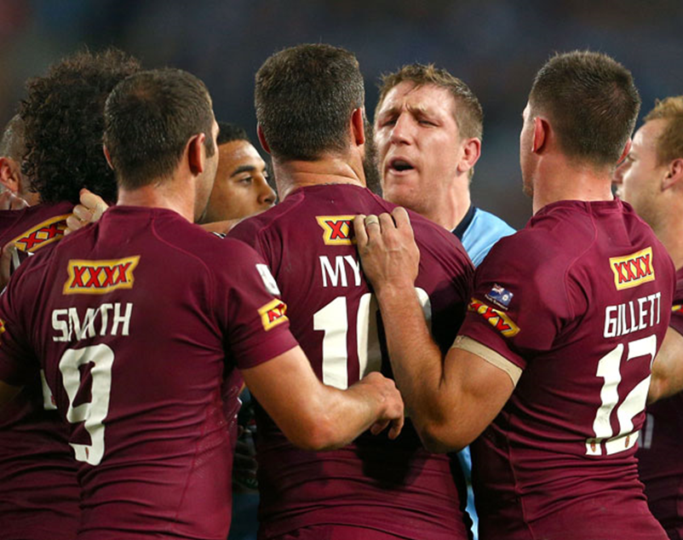
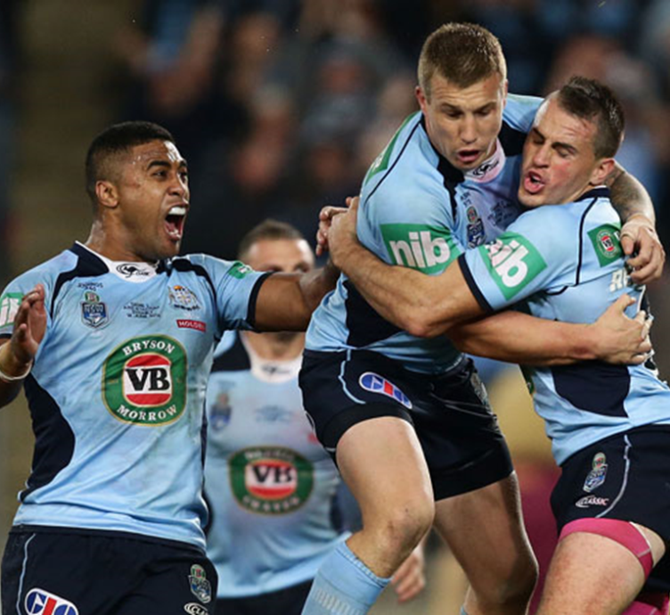
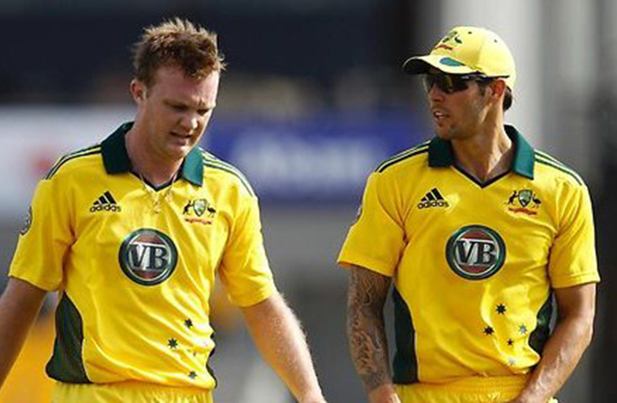
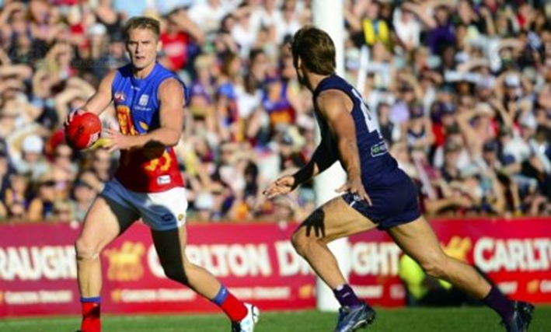

Slide 12
Official Beers of Australian Sport include
VB: Official Beer of Cricket Australia and NRL.
Hahn Super Dry: Official Beer of Qantas Wallabies.
XXXX: Official Beer of Queensland Cricket.
XXXX: Official Beverage Sponsor of rugby league in Queensland.
XXXX Gold: Official Beer of 14th Australian Masters Games.
James Boag: Official Beer of Australian Moto Grand Prix; Official Beer & Cider Partner of the Australian Turf Club.

Slide 13
Official Wines of Australian Sport include
Hardys Wine: Official Wine of Cricket Australia
Glen McGrath: Official Hardys Cricket Ambassador
Crush Fine Wines: Official Wine of Formula 1 Australian Grand Prix
Wolf Blass: Official Wine Sponsor for 2015 ICC Cricket World Cup
De Bortoli Wines: Official Wine Supplier to Queensland Cricket
St Hallett Wines: Official Wine of the Qantas Wallabies
Jacob’s Creek: Official Wine Supplier of the Australian Open
Jack Rabbit: the Official Wine of the Australian Masters Games
Tempus Two: the Official Wine Partner of the Victorian Polo Club
Crush Wines: Official Wine Partner of the Polo in the City Series

Slide 14
Official Spirits of Australian Sport include
Johnnie Walker: Official Whisky of Formula 1
Wild Turkey: Official Spirit of the NRL
Jim Beam: Official Spirit of V8 Supercars

Slide 15
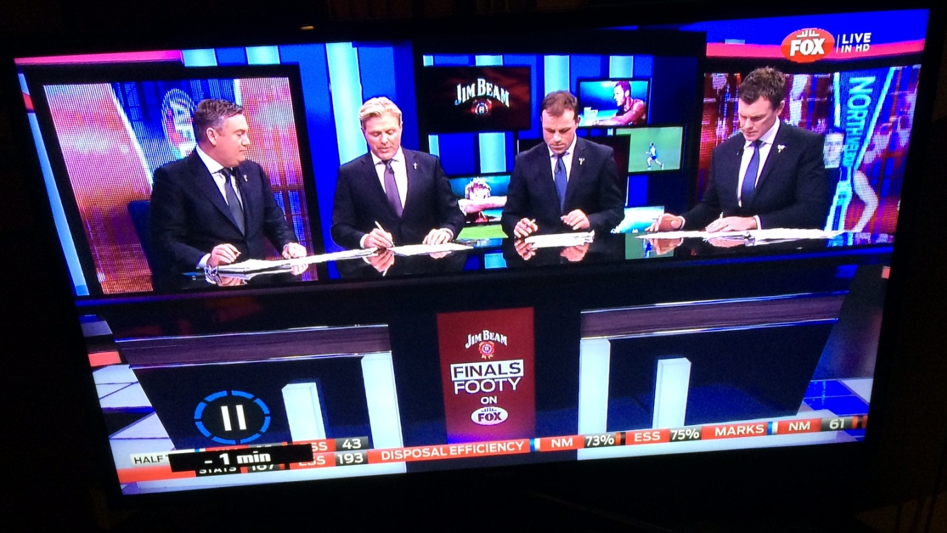
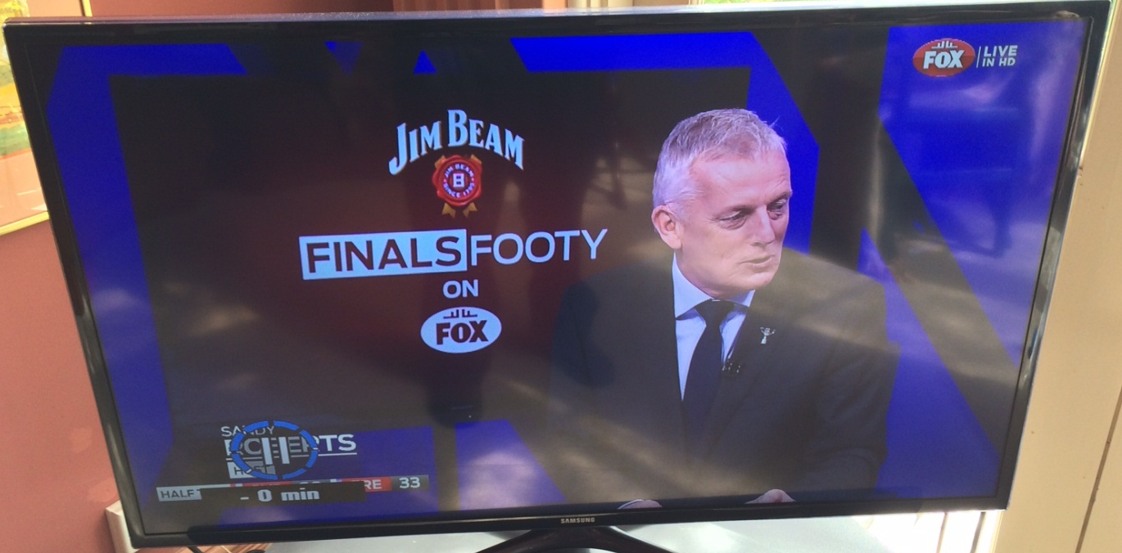

Slide 16
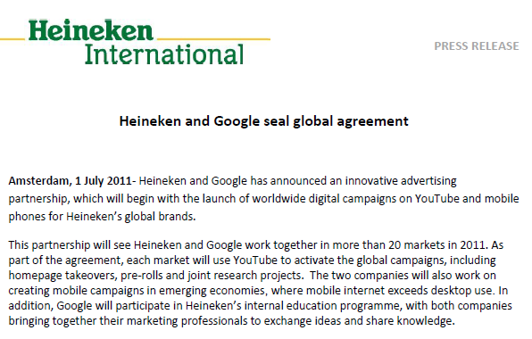
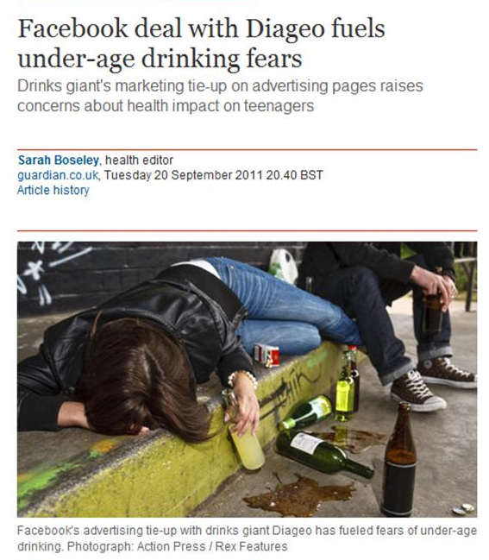
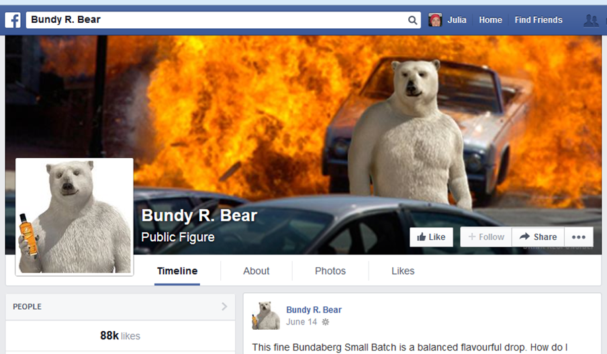

Slide 17
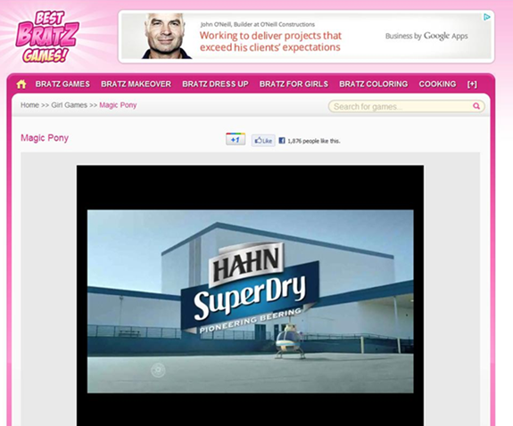
“There is, however, no code or regulation which prescribes where alcohol ads can be placed on the internet. This means that the appearance of an alcohol ad on a children’s gaming site does not of itself offend a specific requirement of the ABAC or any other code applying to alcohol advertising.” – ABAC, Jan 2012

Slide 18
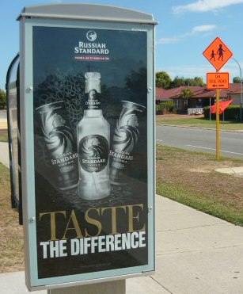
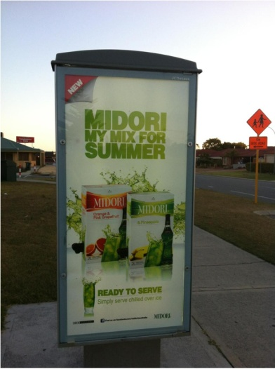
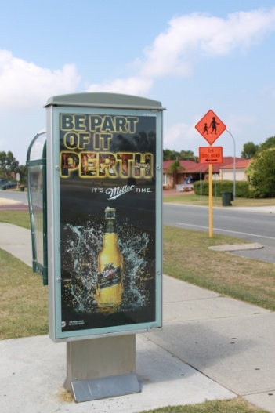
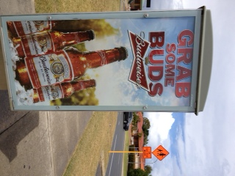
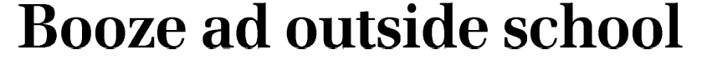

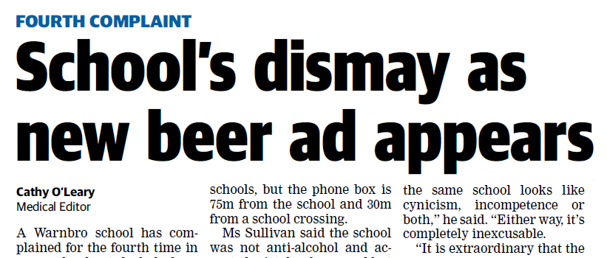

Slide 19
The Failure of Self-regulation
Fails to cover the entire industry
Fails to penalise non-compliance
Fails to cover major areas of marketing
Fails to deal with placement
Fails to keep pace with technology
Fails to be proactive
Does not recognise failings

Slide 20
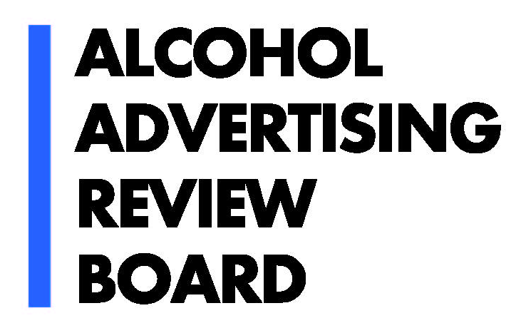
Mission:
To administer an independent alcohol advertising complaint review service to help protect the community from inappropriate alcohol advertising and encourage effective regulation of alcohol advertising.

Slide 21
Aims:
Provide an independent system of alcohol ad review;
Support the community to respond to inappropriate alcohol advertising;
Ensure the complaint process is easy for community members to engage in; and
Address the content and placement of all forms of alcohol advertising.

Slide 22
Content and Placement Codes:
Set criteria for acceptable alcohol advertising.
Cover all forms of advertising in Australia.
Content code applies the industry’s own standards.
Placement code seeks to reasonably reduce young people’s exposure to advertising.

Slide 23
Procedures:
Advertisers are given an opportunity to respond to complaints.
Panel members consider the ad with regard to the Code.
Produce determination reports.
Name and shame alcohol companies that advertise irresponsibly.

Slide 24
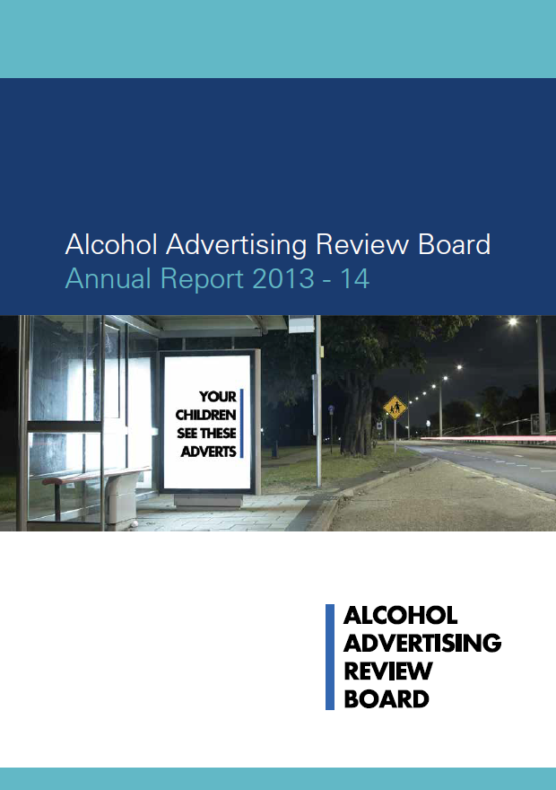
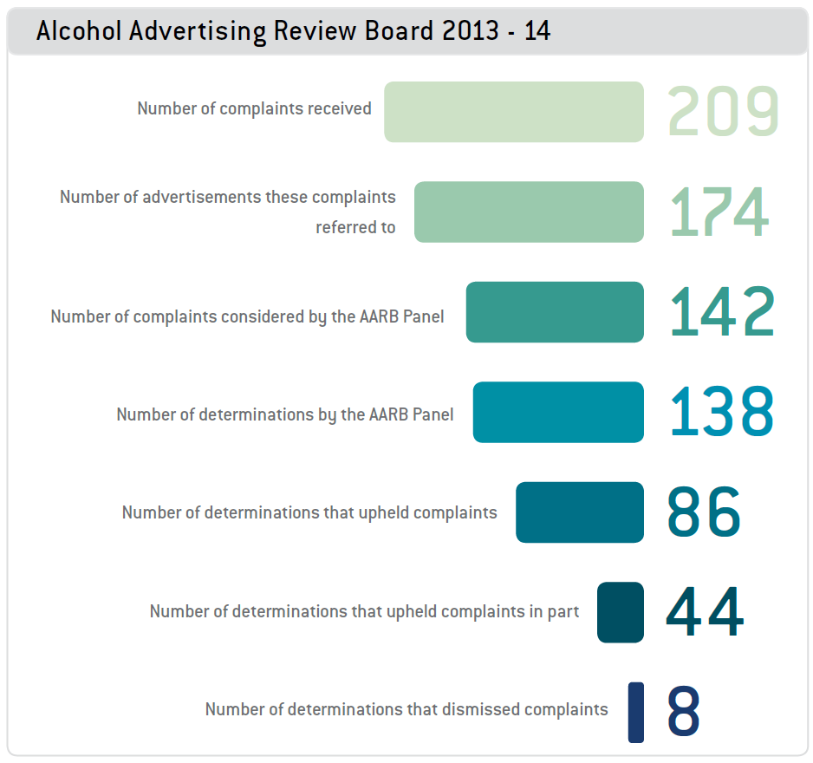

Slide 25
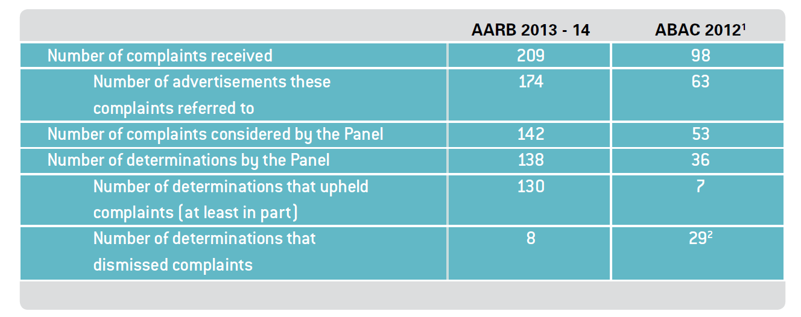
AARB and ABAC comparison
The ABAC 2013 Annual Report showed that the ABAC Scheme received 182 complaints in 2013:
The complaints referred to 78 advertisements;
69 complaints were considered by the ABAC Panel;
36 determinations were made;
  20 determinations upheld complaints (at least in part); and
  4 determinations upheld complaints in full.

Slide 26
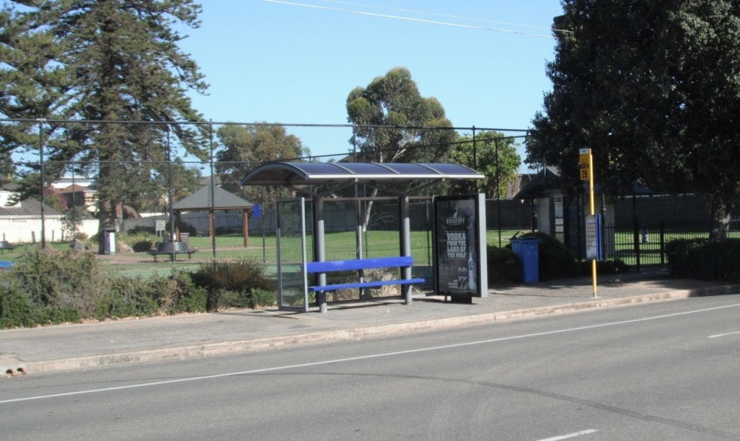
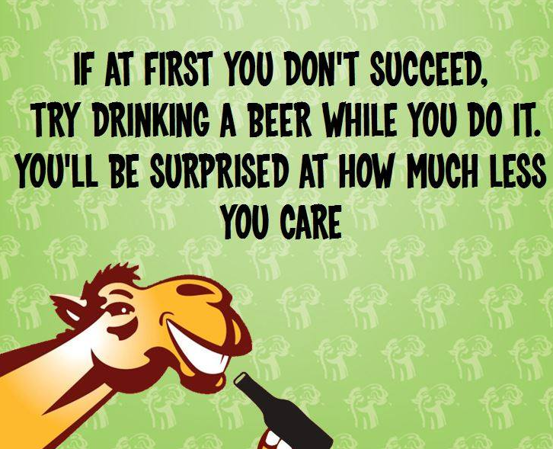

Alcohol ad on a bus stop next to a children’s playground – REMOVED
Thirsty Camel SA Facebook content-
REMOVED
Beer ad before a children’s film -REMOVED

Slide 27
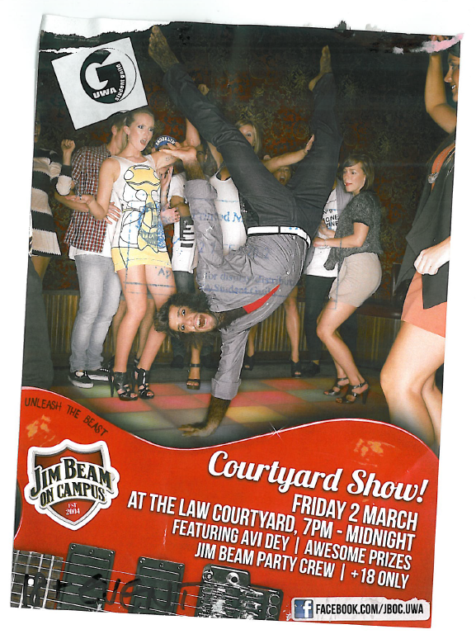
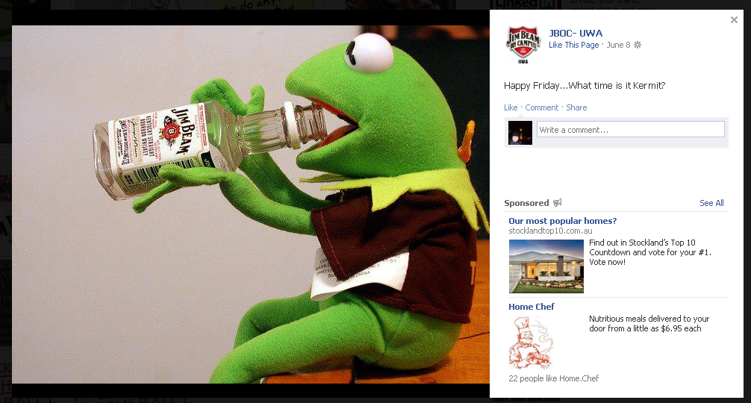
Jim Beam on Campus
ENDED

Slide 28
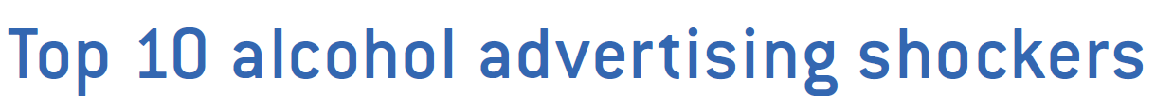
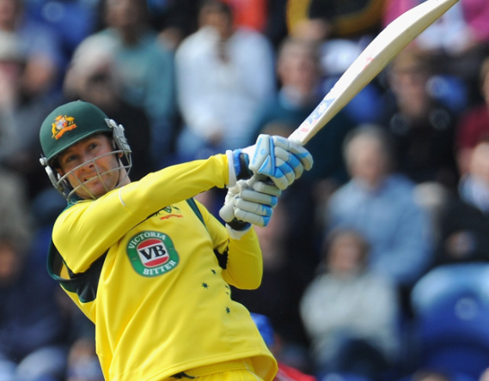
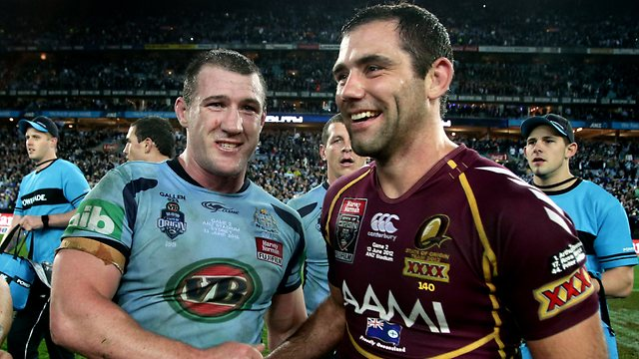
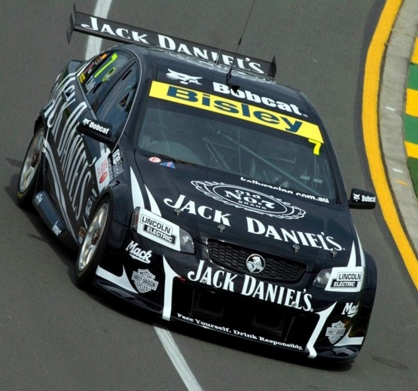
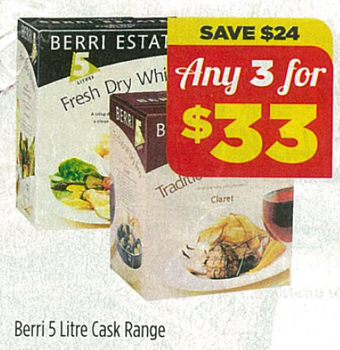
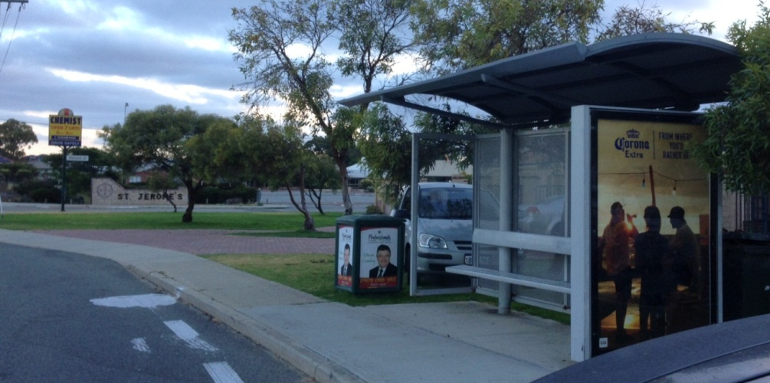
Alcohol sponsorship of sport
Woolworths and Coles cask wine price promotions
Corona bus stop advertisement outside a primary school

Slide 29
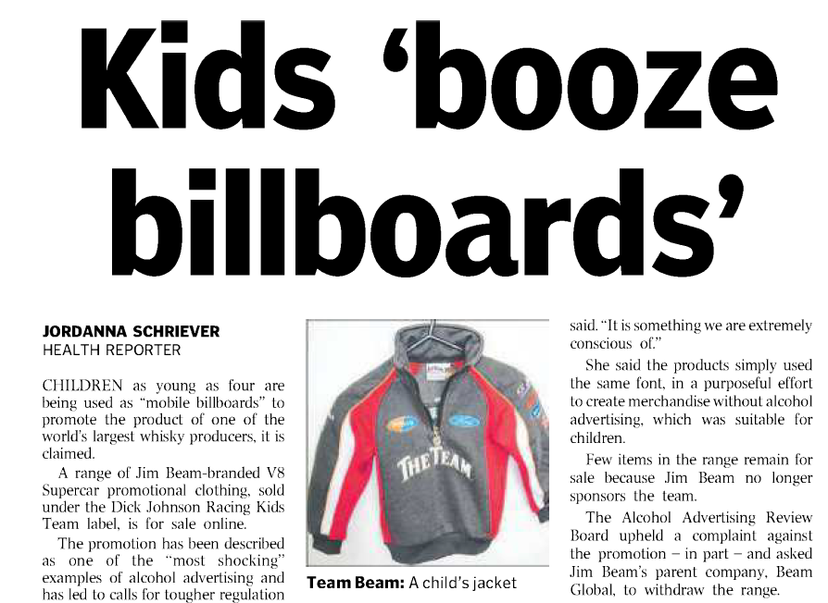
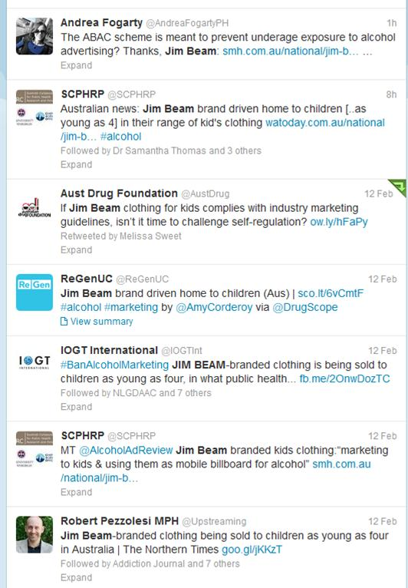
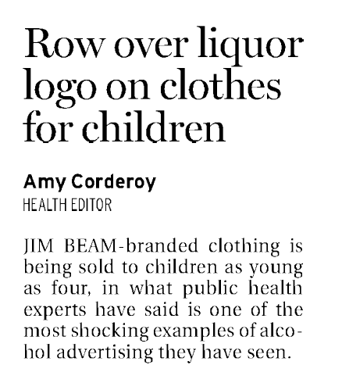
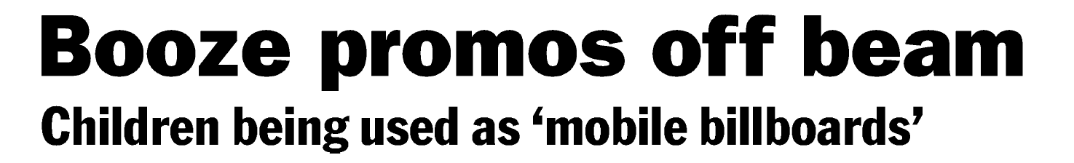

Slide 30
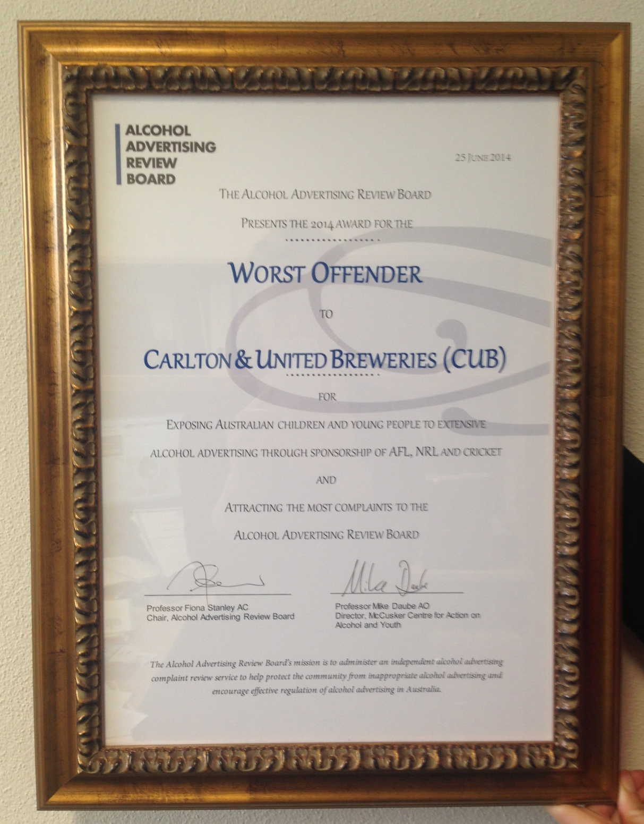

Slide 31
Advantages of the AARB
Independent of alcohol and ad industries.
Covers all forms of advertising (and marketing, promotion etc) in Australia.
Strong Code provisions – including placement.
Simple to lodge complaints.
Proactive advertising monitoring role.
Publicly names and shames irresponsible advertisers.

Slide 32
International context
Countries with complete or partial bans: Turkey, Norway, Iceland, Faroe Islands, France, and Sweden
France – Loi Evin
Recent activity in Finland and Lithuania

Slide 33
What needs to be done
1. Close the loophole that allows alcohol advertising during live sporting broadcasts before 8.30pm on commercial free‐to‐air television.

Slide 34
2. Replace the current system of industry self‐regulation with a legislative framework for regulating alcohol advertising, overseen by an independent body, with mandatory controls which cover all types of marketing activities, flexible enough to adapt and respond to changing environments, and include penalties for non‐compliance

Slide 35
3. Phase out alcohol sponsorship of sporting and cultural events that expose young people to alcohol promotions.

