Slide 1
Australian Medical Association Council of Doctors in Training in 2020/COVID
Hashim (Hash) Abdeen (Chair AMACDT)

Slide 2
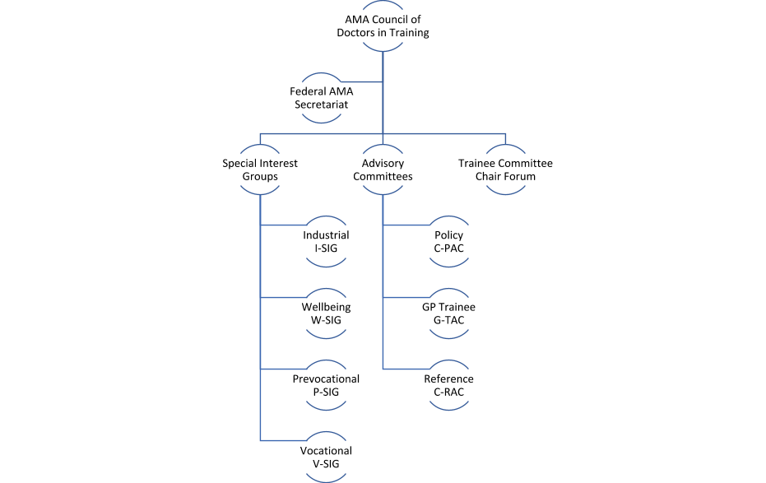
CDT Structure

Slide 3
AMACDT REPORT 20th August 2020
DEPARTMENT OF HEALTH Junior Doctor WEBINARS

Slide 4
AMACDT REPORT 20th August 2020
Medical Training Survey – AMACDT Specialist Trainee Experience Report

Slide 5
AMACDT REPORT 20th August 2020
National Mental Health Framework Launch planned October 2020 with the Australian Health Minister

Slide 7
Medical College Trainee Forums

Slide 8
Trainee Forum – 11th August 2020
JDN In 10 years!

Slide 9
Congrats WMA JDN on 10 Years!!

