Slide 1

Australian Medical Association
28th October 2014
“Violence and the social costs of alcohol”

Slide 2
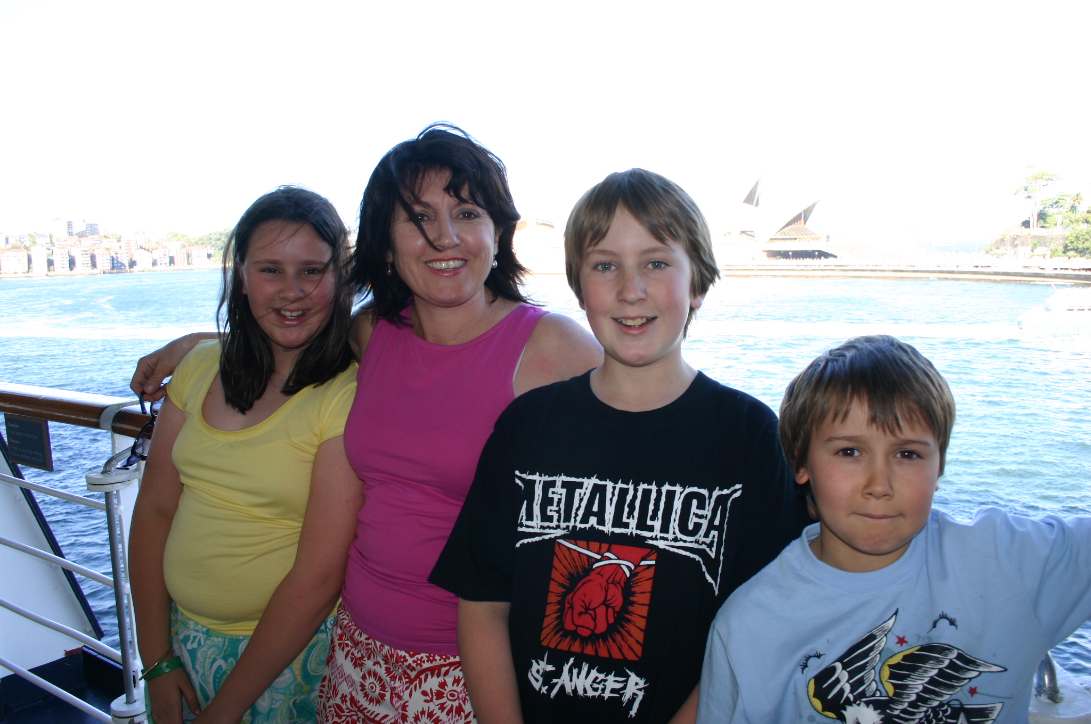
Thomas Kelly Youth Foundation

Slide 3

Video

Slide 4
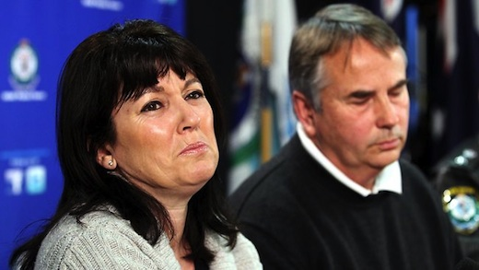
Police Headquarters, Sydney (10/7/12)

Slide 5
Our world changed
NSW Police (Kings Cross & City LAC)
Homicide division
Coroner (Glebe)
Medical experts and opinion
Principals of Schools and Vice-Chancellors of Universities
Media
Office of Director of Public Prosecutions (ODPP)
Homicide Victim Support Group (founded by the parents of
Ebony Simpson & Anita Cobby)
Family and younger children

Slide 6
The Legal process began:
ODPP (commencement: 23/08/12)
HVSG meeting (Charles Street, Parramatta - Police HQ: 27/02/13)
Local Court, Liverpool Street, Sydney, plea bargain (18/06/13) (22/61 CP’s. Daniel)
Supreme Court, arraignment (02/08/13 & 06/09/13)
Supreme Court, sentencing hearing (25/10/13)
Supreme Court, sentencing (08/11/13)
Supreme Court, Court of Criminal Appeal (07/05/14) – NSW Chief Justice:
Tom Bathurst, Justice P. Johnson, Justice R.A. Hulme
High Court (12/12/14), “Application for Special Leave to Appeal”

Slide 7
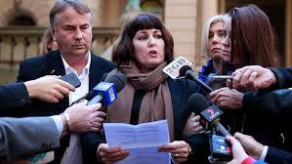
Local court (plea bargain) – 18/06/2013
“It’s time that we all came to the same realisation just who the victim is and it’s not the offender. So please stop treating them as the victim.”

Slide 8

Lady Justice – 08/11/2013

Slide 9
Lady Justice has often been depicted wearing a blindfold.
The blindfold represents objectivity, in that justice is or should be meted out objectively, without fear or favour, regardless of identity, money, power, or weakness; blind justice and impartiality.

Slide 10
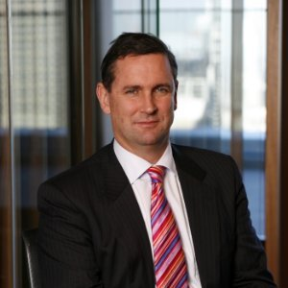
Alexander “Sandy” Street (SC)

Slide 11
There will always be a much greater vocal noise from the critics of criminal law reform than the quiet majority that generally welcome the reforms to make the community safer.

Slide 12
That principal object is the cultural change needed to reduce alcohol/drug fuelled violence in the community and to create a Take Kare culture for the safety and wellbeing of both our youth and the whole of our community.

Slide 13
TKY Foundation - milestones
“One Punch” law
Mandatory Minimum Sentencing (Eight years)
Section 18 (1) (a) NSW Crimes Act 1900 – defines ‘Murder’
& review of NSW Sentencing Act (in progress)
Family “Victim impact Statements” (now considered in sentencing)
Six offences for Grievous bodily Harm, minimum non-parole period

Slide 14
TKY Foundation - milestones
Research undertaken by newDemocracy with citizens jury: “How can we ensure we have a vibrant and safe Sydney nightlife?”
Increased public awareness of violence associated with alcohol.
“Take Kare, Safe Space” program to be trialed for 3 months in CBD, with effect from 05th December 14, with Take Kare Ambassadors.
Partners: City of Sydney, NSW State Government, Salvation Army,
St. Vincents Hospital, NSW Police, TKY Foundation.

Slide 15
UNSW, Faculty of Medicine (National Drug and Alcohol Research Centre).
Addition of CCTV Cameras x 11 ($350,000) in CBD.
Establishment of the Foundation with full ACNC / DGR charitable status, with Take Kare platform, within eight months.
The Foundation is supported by leaders in the community across government, corporate, councils and families.

Slide 16
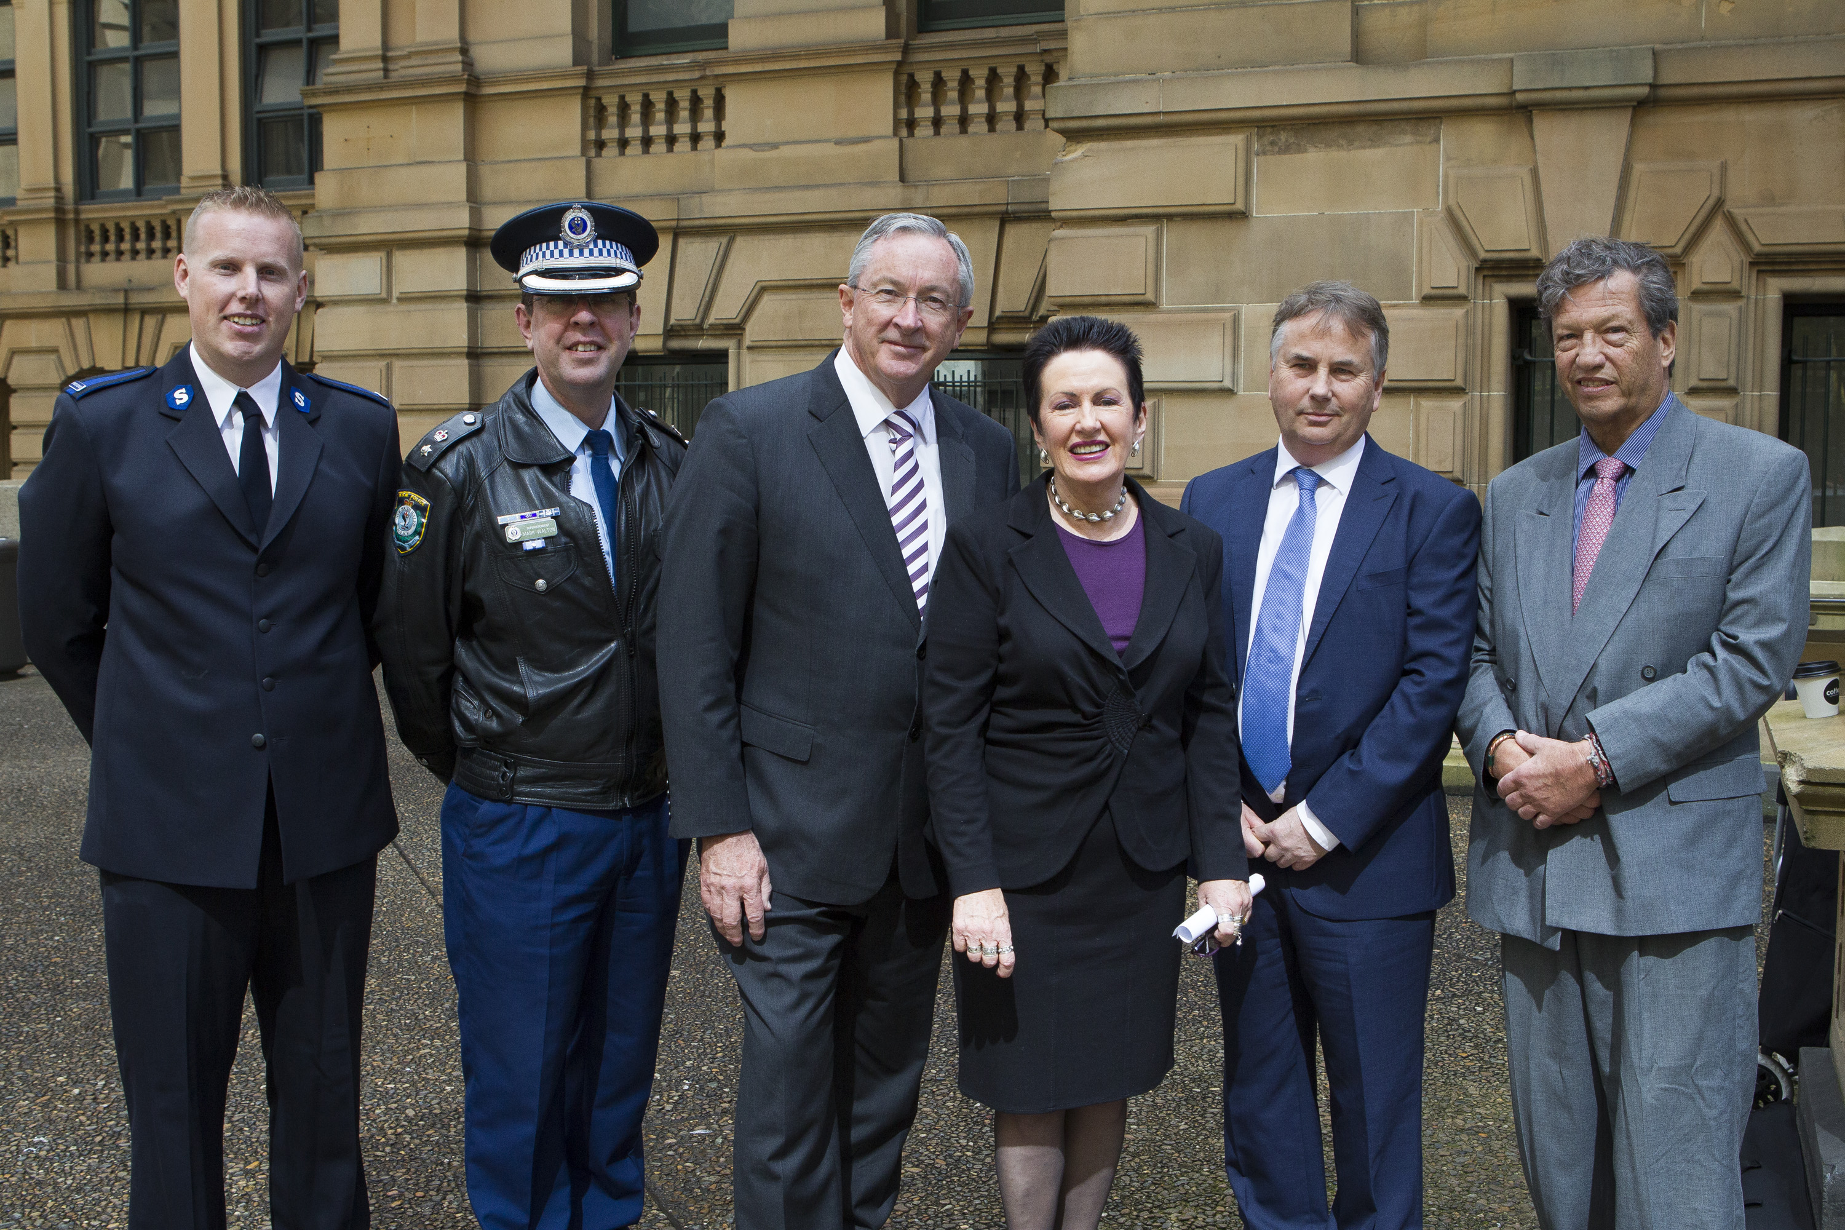

Slide 17
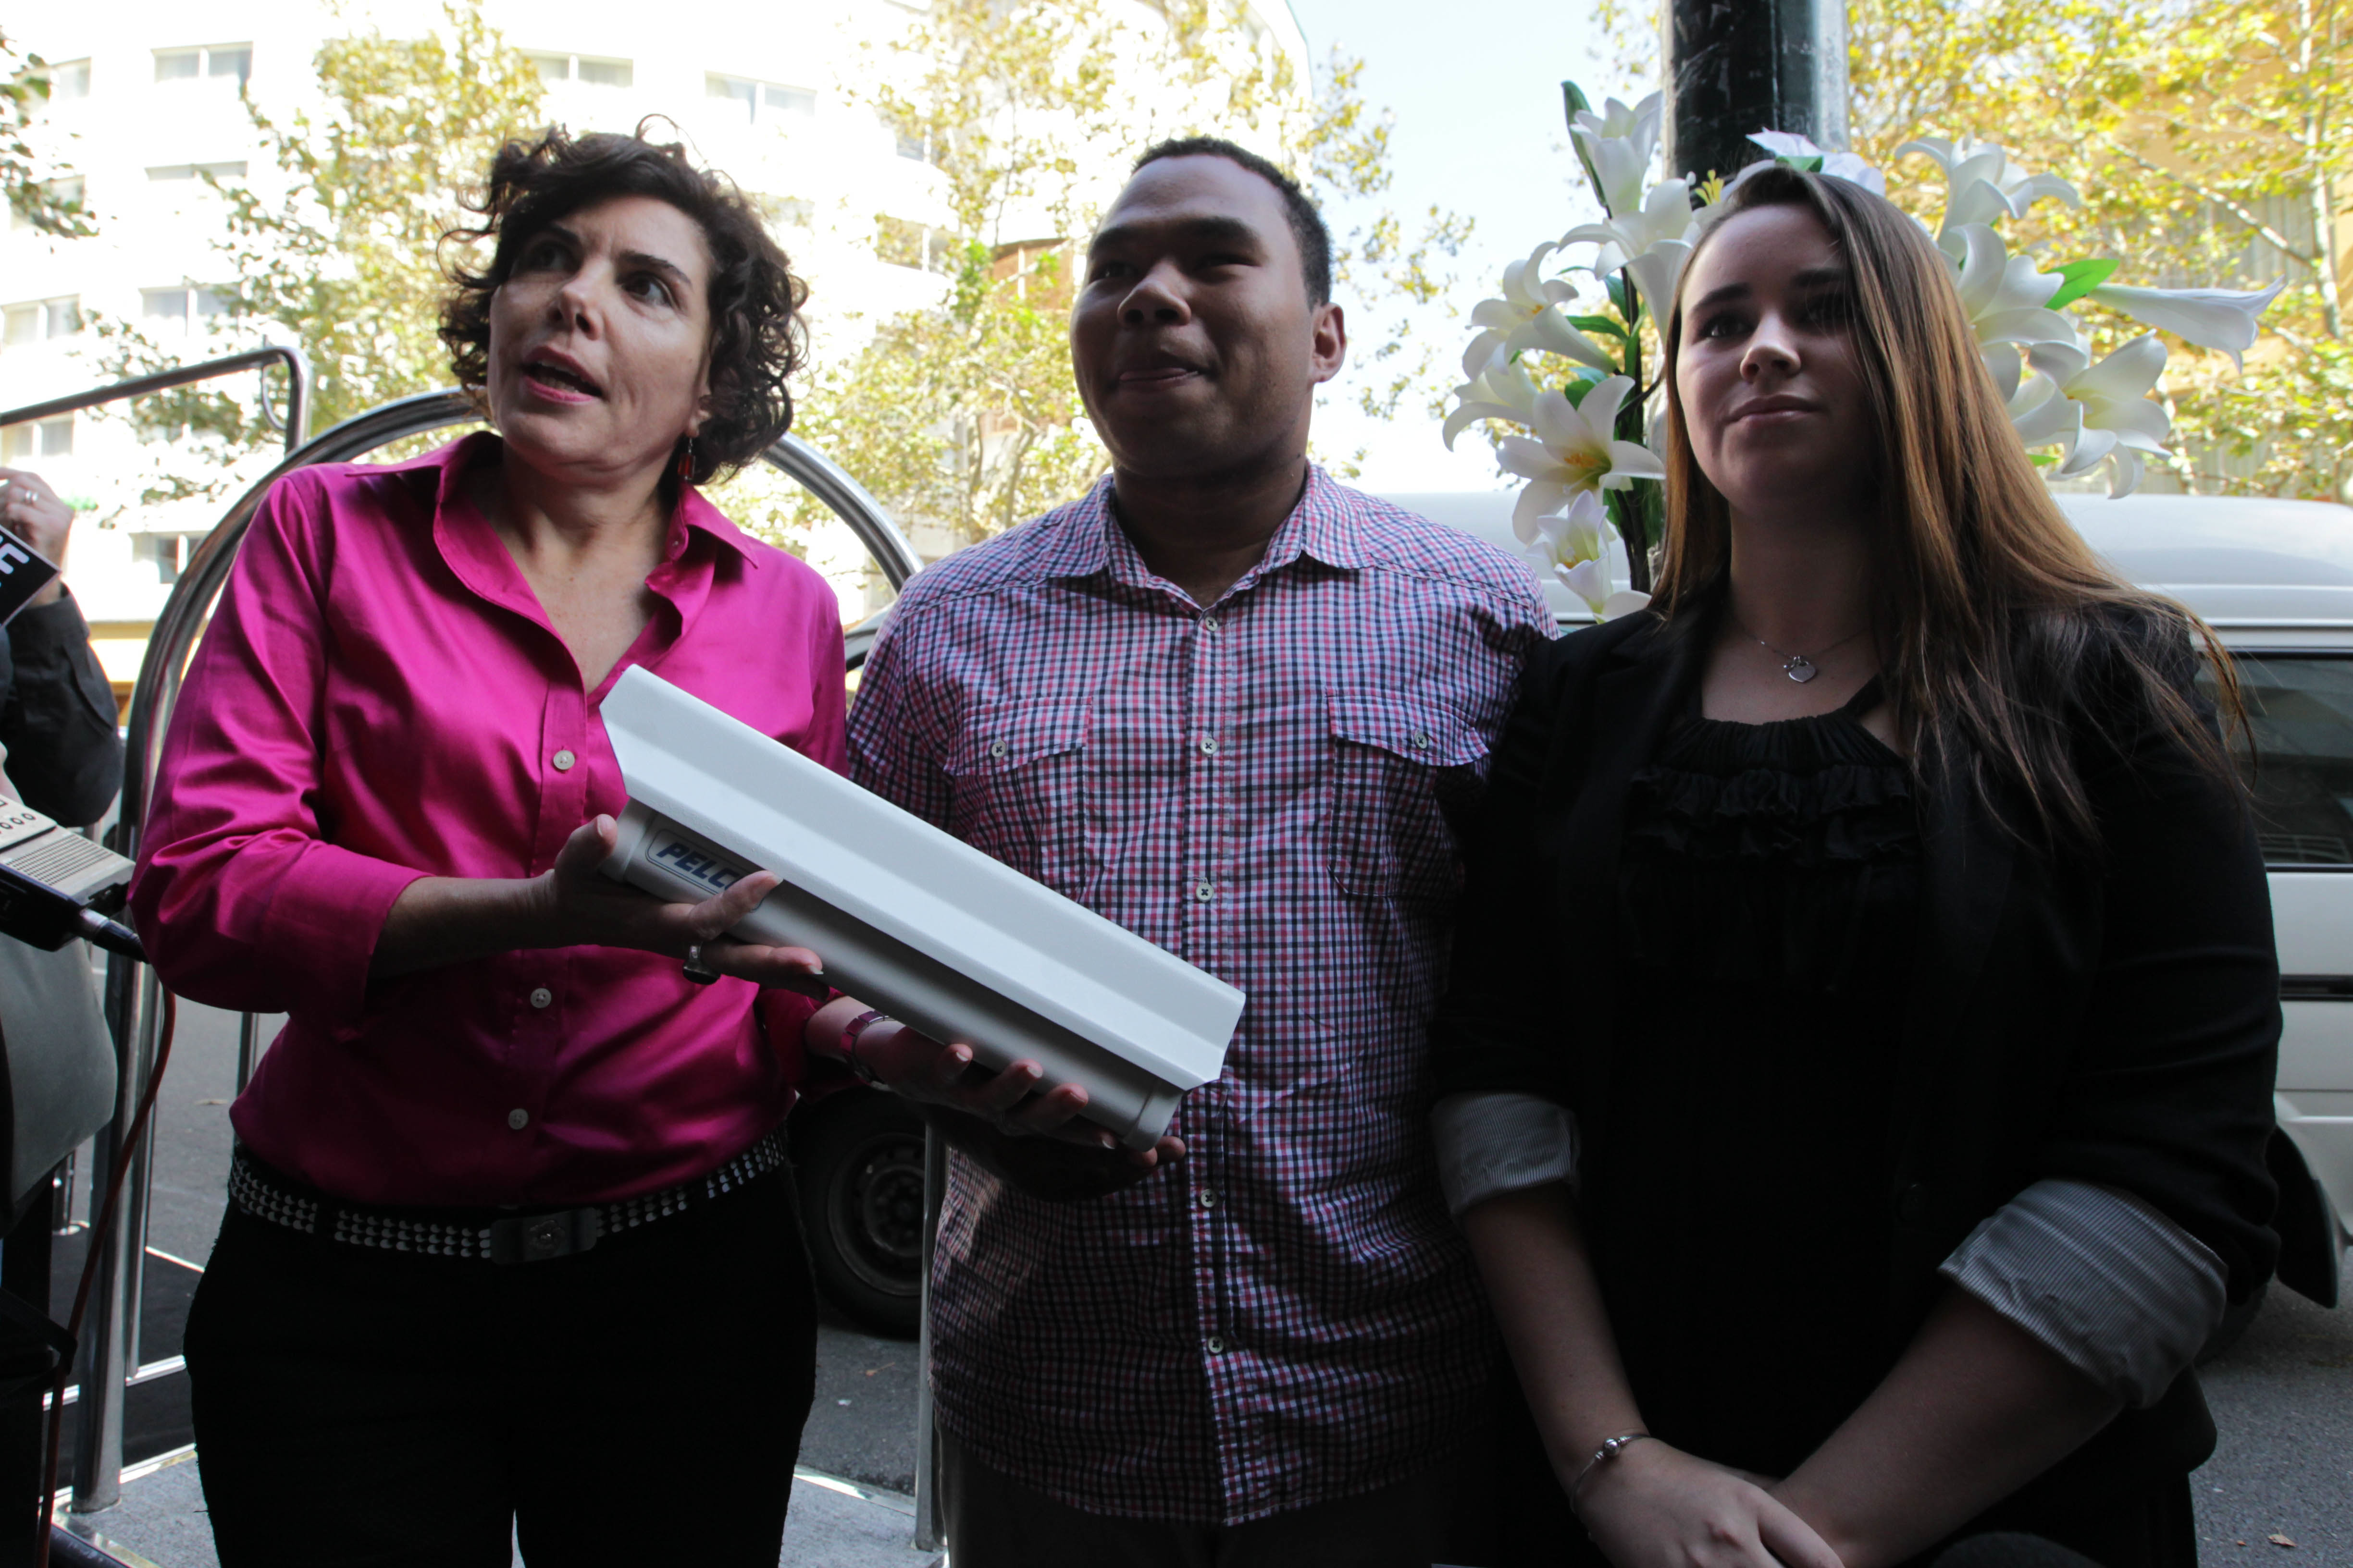
Jenny Green, Chris Lee, Madeleine Kelly

Slide 18
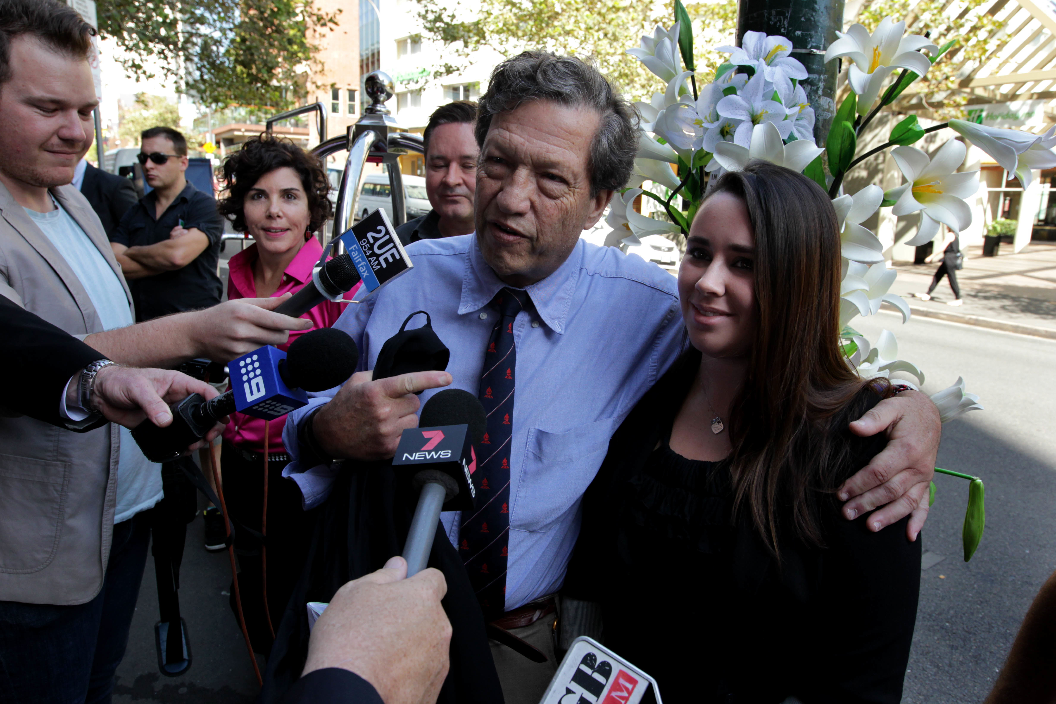
Jenny Green, Geoff Field, Gordian Fulde, Madeleine Kelly

Slide 19
Recommendations
1. Financial support for victims of homicide via both the Commonwealth and State Governments.
2. Is there a place for the involvement of the liquor industry - “corporate social responsibility platforms”? - that will assist to make a difference.
3. Alcohol sponsorship and promotion within sports.
4. Education of the harms of alcohol via: i) Advertising (Print, TV, radio, outdoor, Digital) ii) Within schools K-Y12: Respect, Responsibility & Relationships. iii) Proper parenting.
5. Continuation of lock-outs with early closing enabled across the State.

Slide 20
Recommendations
6. Alcohol availability.
7. Volumetric taxation.
8. Licensing (support provided to residential areas).
9. "Behavioural Change" - Judicial system: clear expectations and guidelines within sentencing, across all alcohol/drug fuelled violence.
10. Appointment of a national university partnership to measure results and provide world’s best practice within each target area.

Slide 21
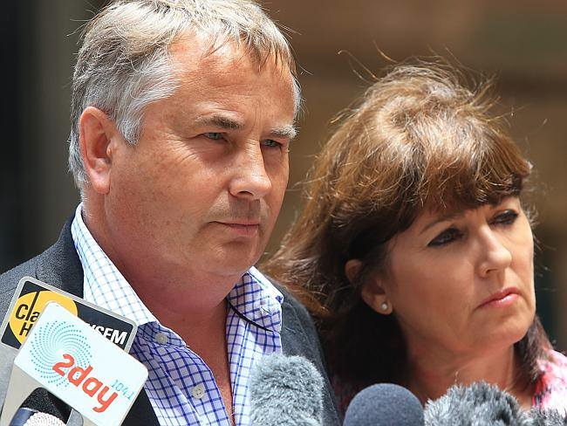
Outcomes 21/01/14

Slide 22


Slide 23

Target Audience

Slide 24

brand

Slide 25


Slide 26
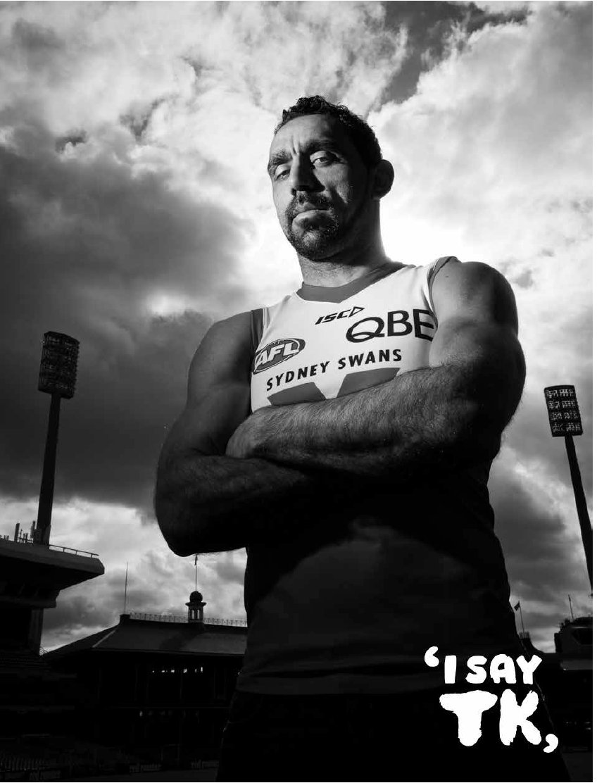
Adam Goodes

Slide 27


Slide 28

Signage

Slide 29
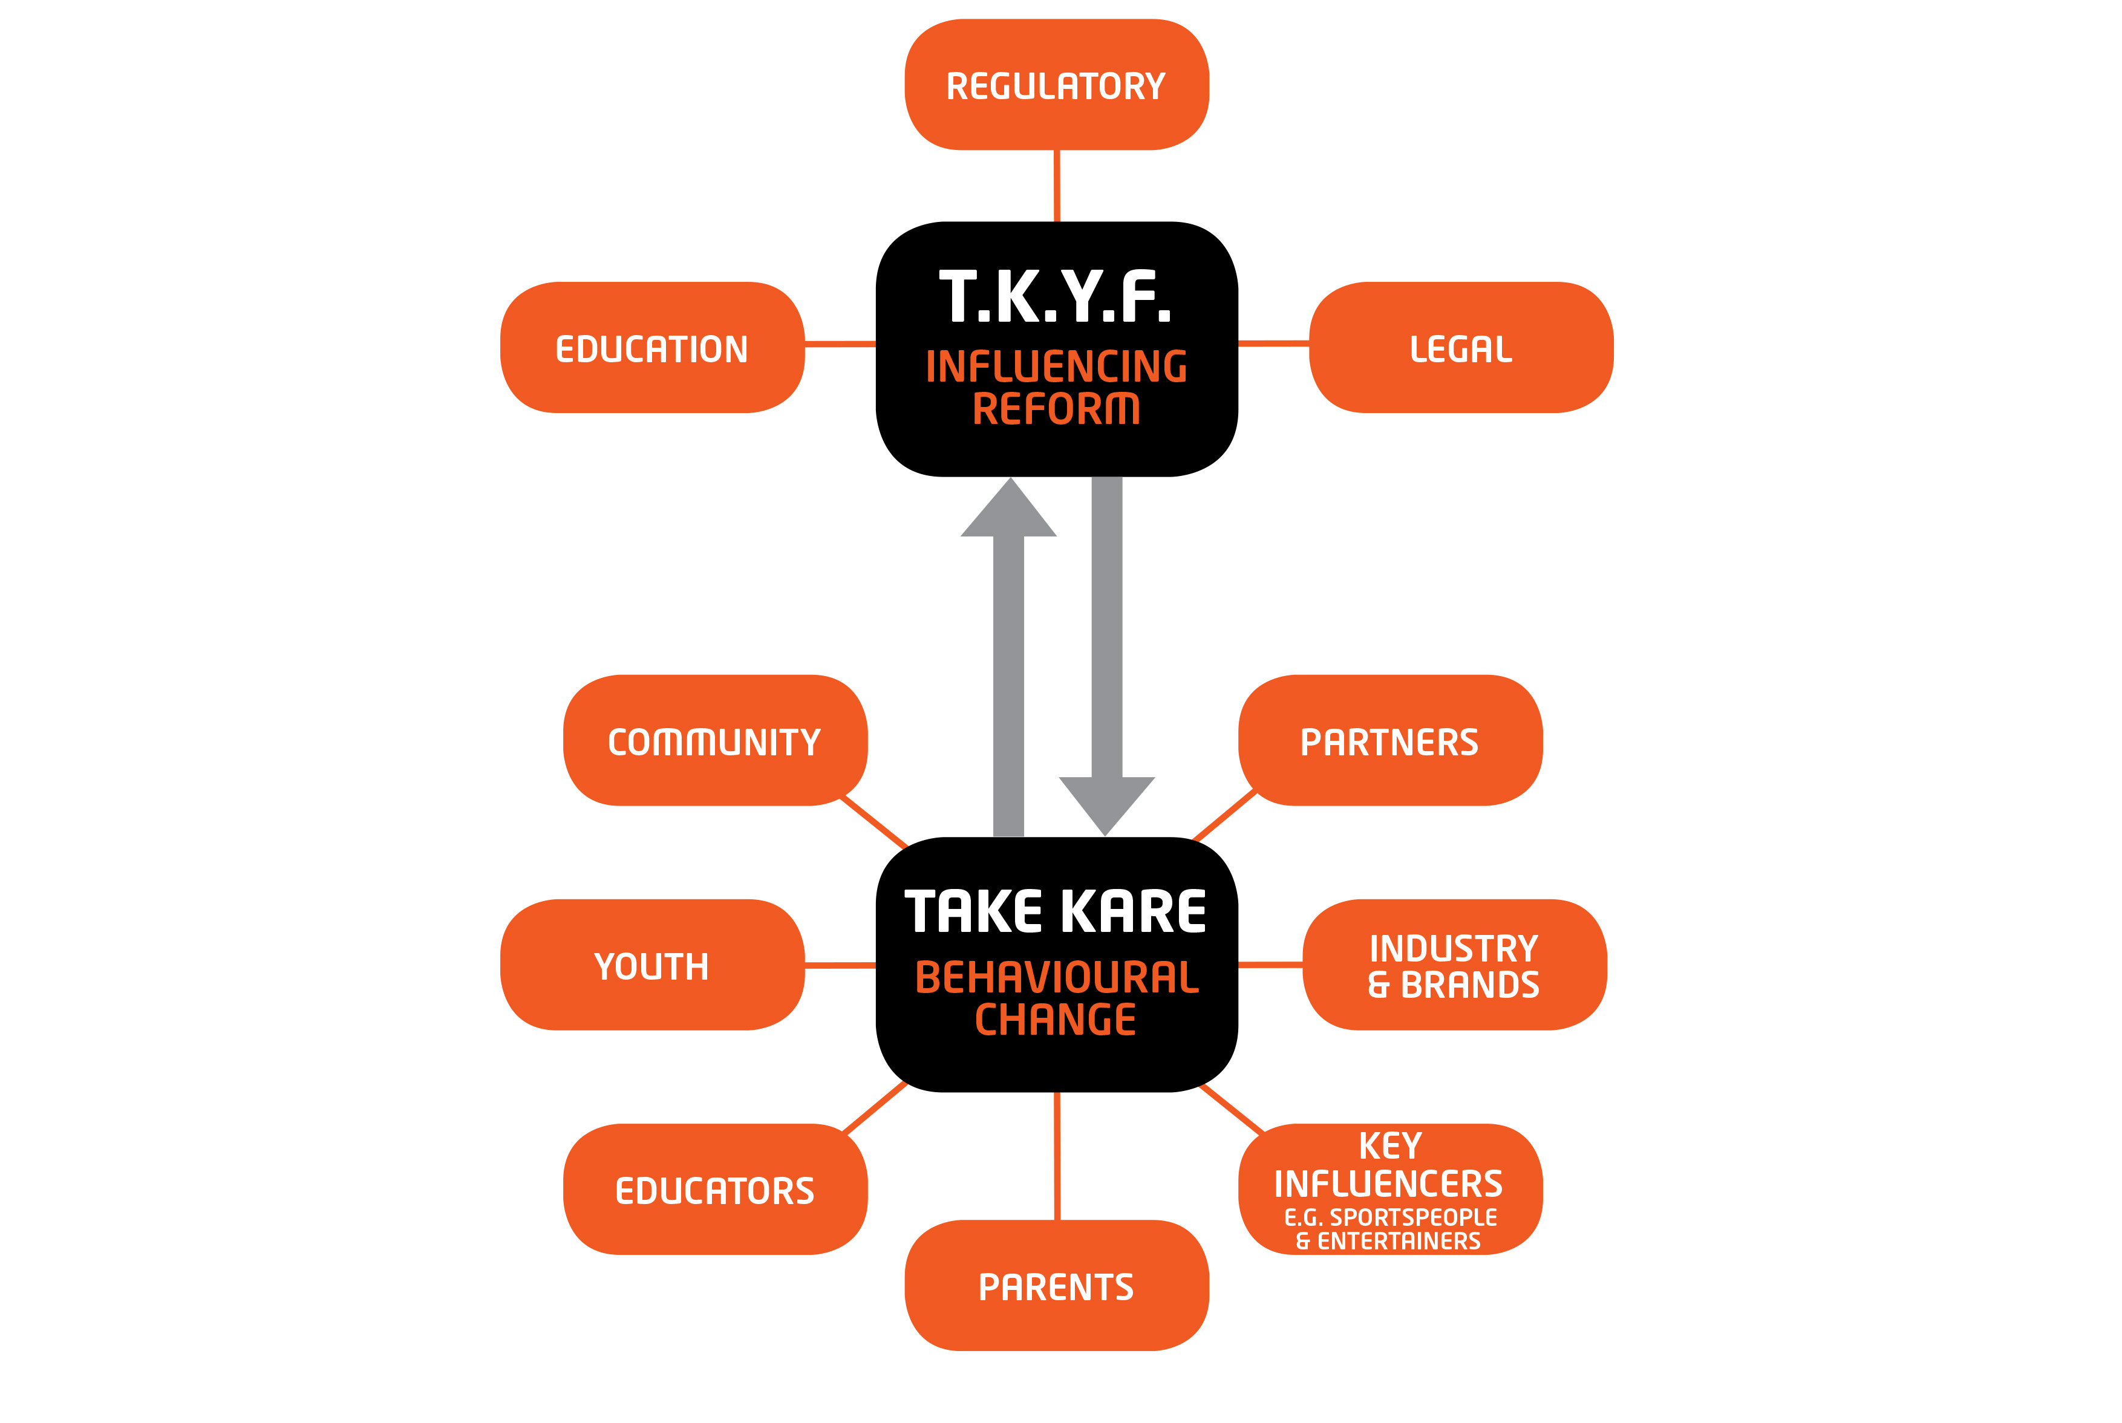

Slide 30
“Our purpose is to make sure our children come home safely”

Slide 31
Target Audience
Our immediate 2 year plan will focus on one or more of the following segments:
    ^{1. Family}
    ^{2. Youth}
    3. Community (awareness via events)
    4. Sport (players, families, partners, fanbase)

Slide 32
"I hope there might be a small amount of comfort knowing there is an army of parents walking beside you.”

Slide 33
Somewhere, somehow things must change.
www.thomaskelly.com.au

